Slide 1

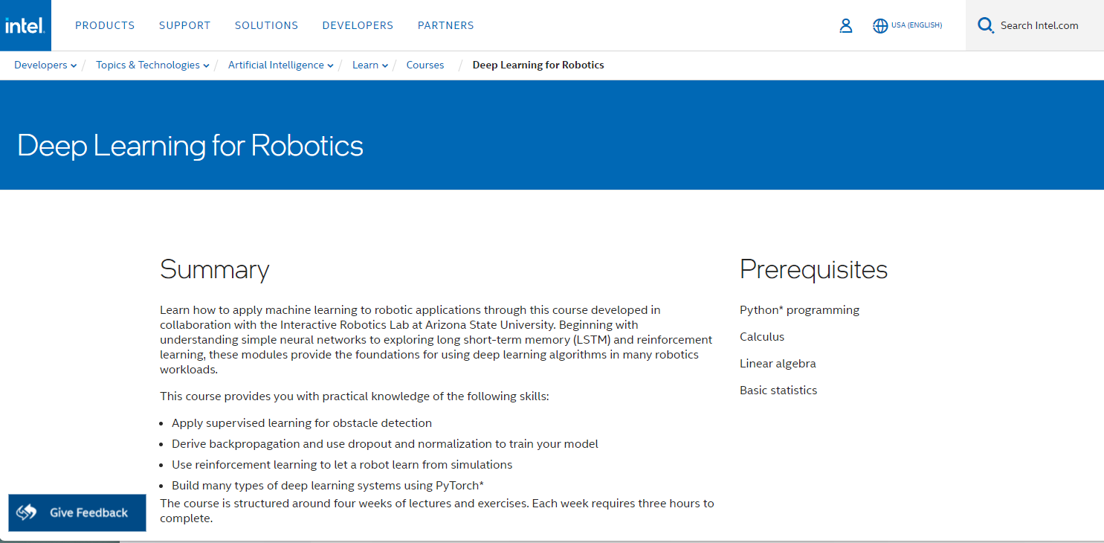

CSC485B Machine Learning for Robotics
SUNY Plattsburgh
Dr. Ned Lecky
Class 16- IDLR Week 2: Robot Kinematics

Slide 2

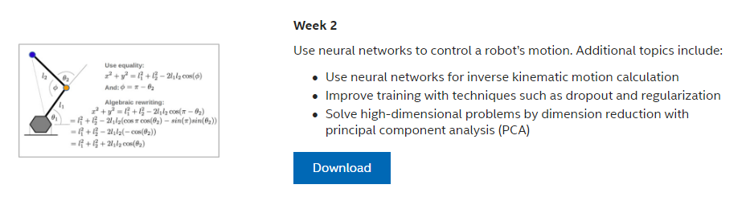



IDLR Week 2

Slide 3

The Basics of Robot Kinematics….
Let’s walkthrough the “classical” way to do robot kinematics
First: Recall how big a radian is?
About 60 degrees. (2pi radians = 360 degrees….)
So a tenth of a radian is about 6 degrees
https://robotics-explained.com/

Slide 4
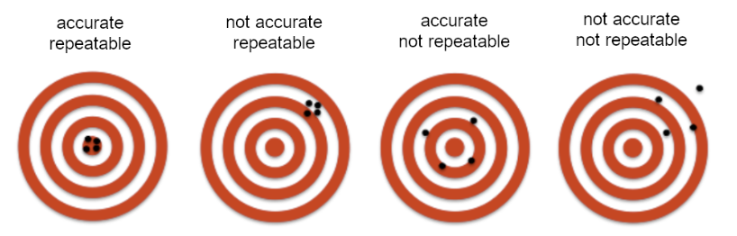
The Exact Kinematics are Inexact
Computing the kinematics might be “easy”
But dimensions and joint parameters might not be known precisely!
Industrial robots quote accuracy like 0.1mm, 0.01mm
Repeatability is typically much better
But: What is accuracy and repeatability?
Other terms for repeatability are reproducibility or - slightly confusing - precision.
Thanks to https://xeryon.com/technology/understanding-precision/

Slide 5
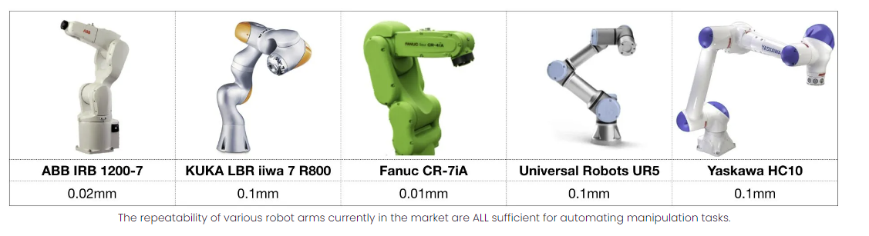
How Accurate and Repeatable?
Bots are pretty good although even 0.1mm won’t let you do fine assembly
How good are humans?
Let’s do an exercise.
Thanks to: https://www.southie.ai/robotics-myth-1-repeatability-and-accuracy

Slide 6
“Humans may have worse kinematic repeatability, but we have a larger basin of convergence when we interact with the environment and the task via sensing and control. The reason is that when we perform tasks, we do not rely on kinematics alone, but instead leverage several sensory modalities to collectively provide feedback during execution of the task. We continuously leverage our vision during execution (see visual servoing), exploit contact and physics with the environment, and reason in both our audio and haptic channels.”
Jay Wong, Southie Autonomy

Slide 7
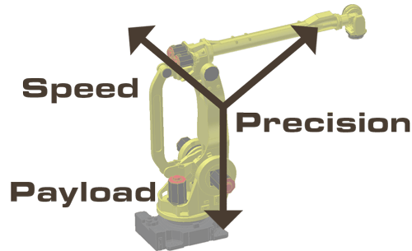
Another Dirty Secret…
A 10kg payload robot that quotes 0.1mm accuracy and 0.01mm repeatability only gives that under certain conditions
What might those be?
UR Demo…
Payload and Envelope Location
Interesting Study by Nikon: https://us.v-cdn.net/6027406/uploads/editor/1v/3p4g3t9rl01s.pdf
Pick Any Two!
(Reminiscent of Good, Fast, Cheap)

Slide 8
So…
Having a good base model for kinematics is fairly easy.
Having it be extremely accurate and potentially evolve over time or with temperature or payload is tricky
Robot manufacturers typically hardcode all sorts of tweaks into their controllers which work if you are properly specifying payload and payload CG into the bot every time you pick something up!
Using ML to extract and tune corrections makes sense
Let’s run through Intel’s material!

